Slide 1
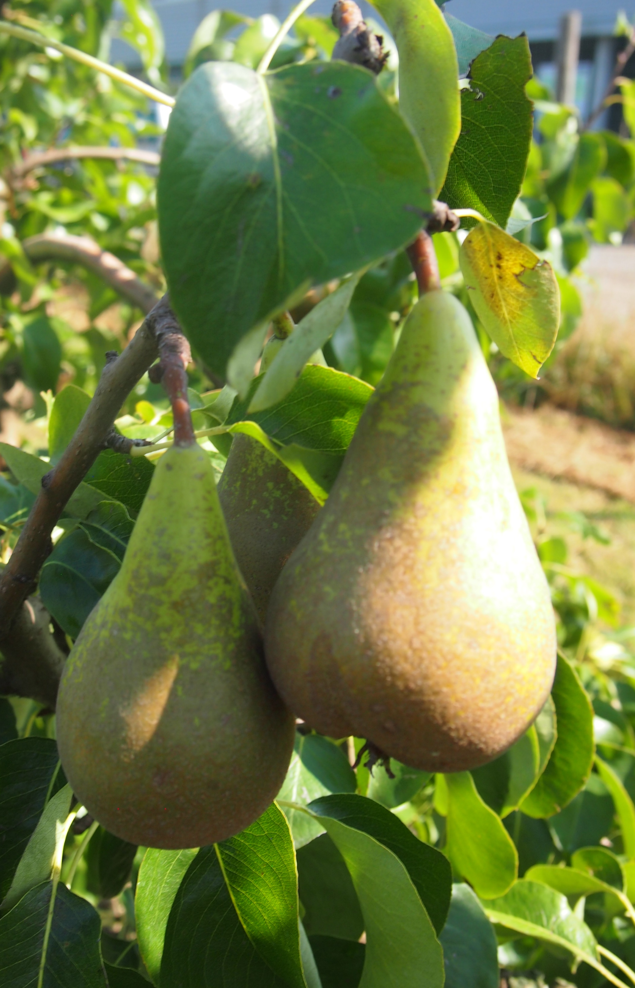




Hanne Claessen (PGCI lab) 03/10/2024 Genomics Core Long Read Sequencing Symposium
de novo assembly of the “Conference” pear genome

Slide 2
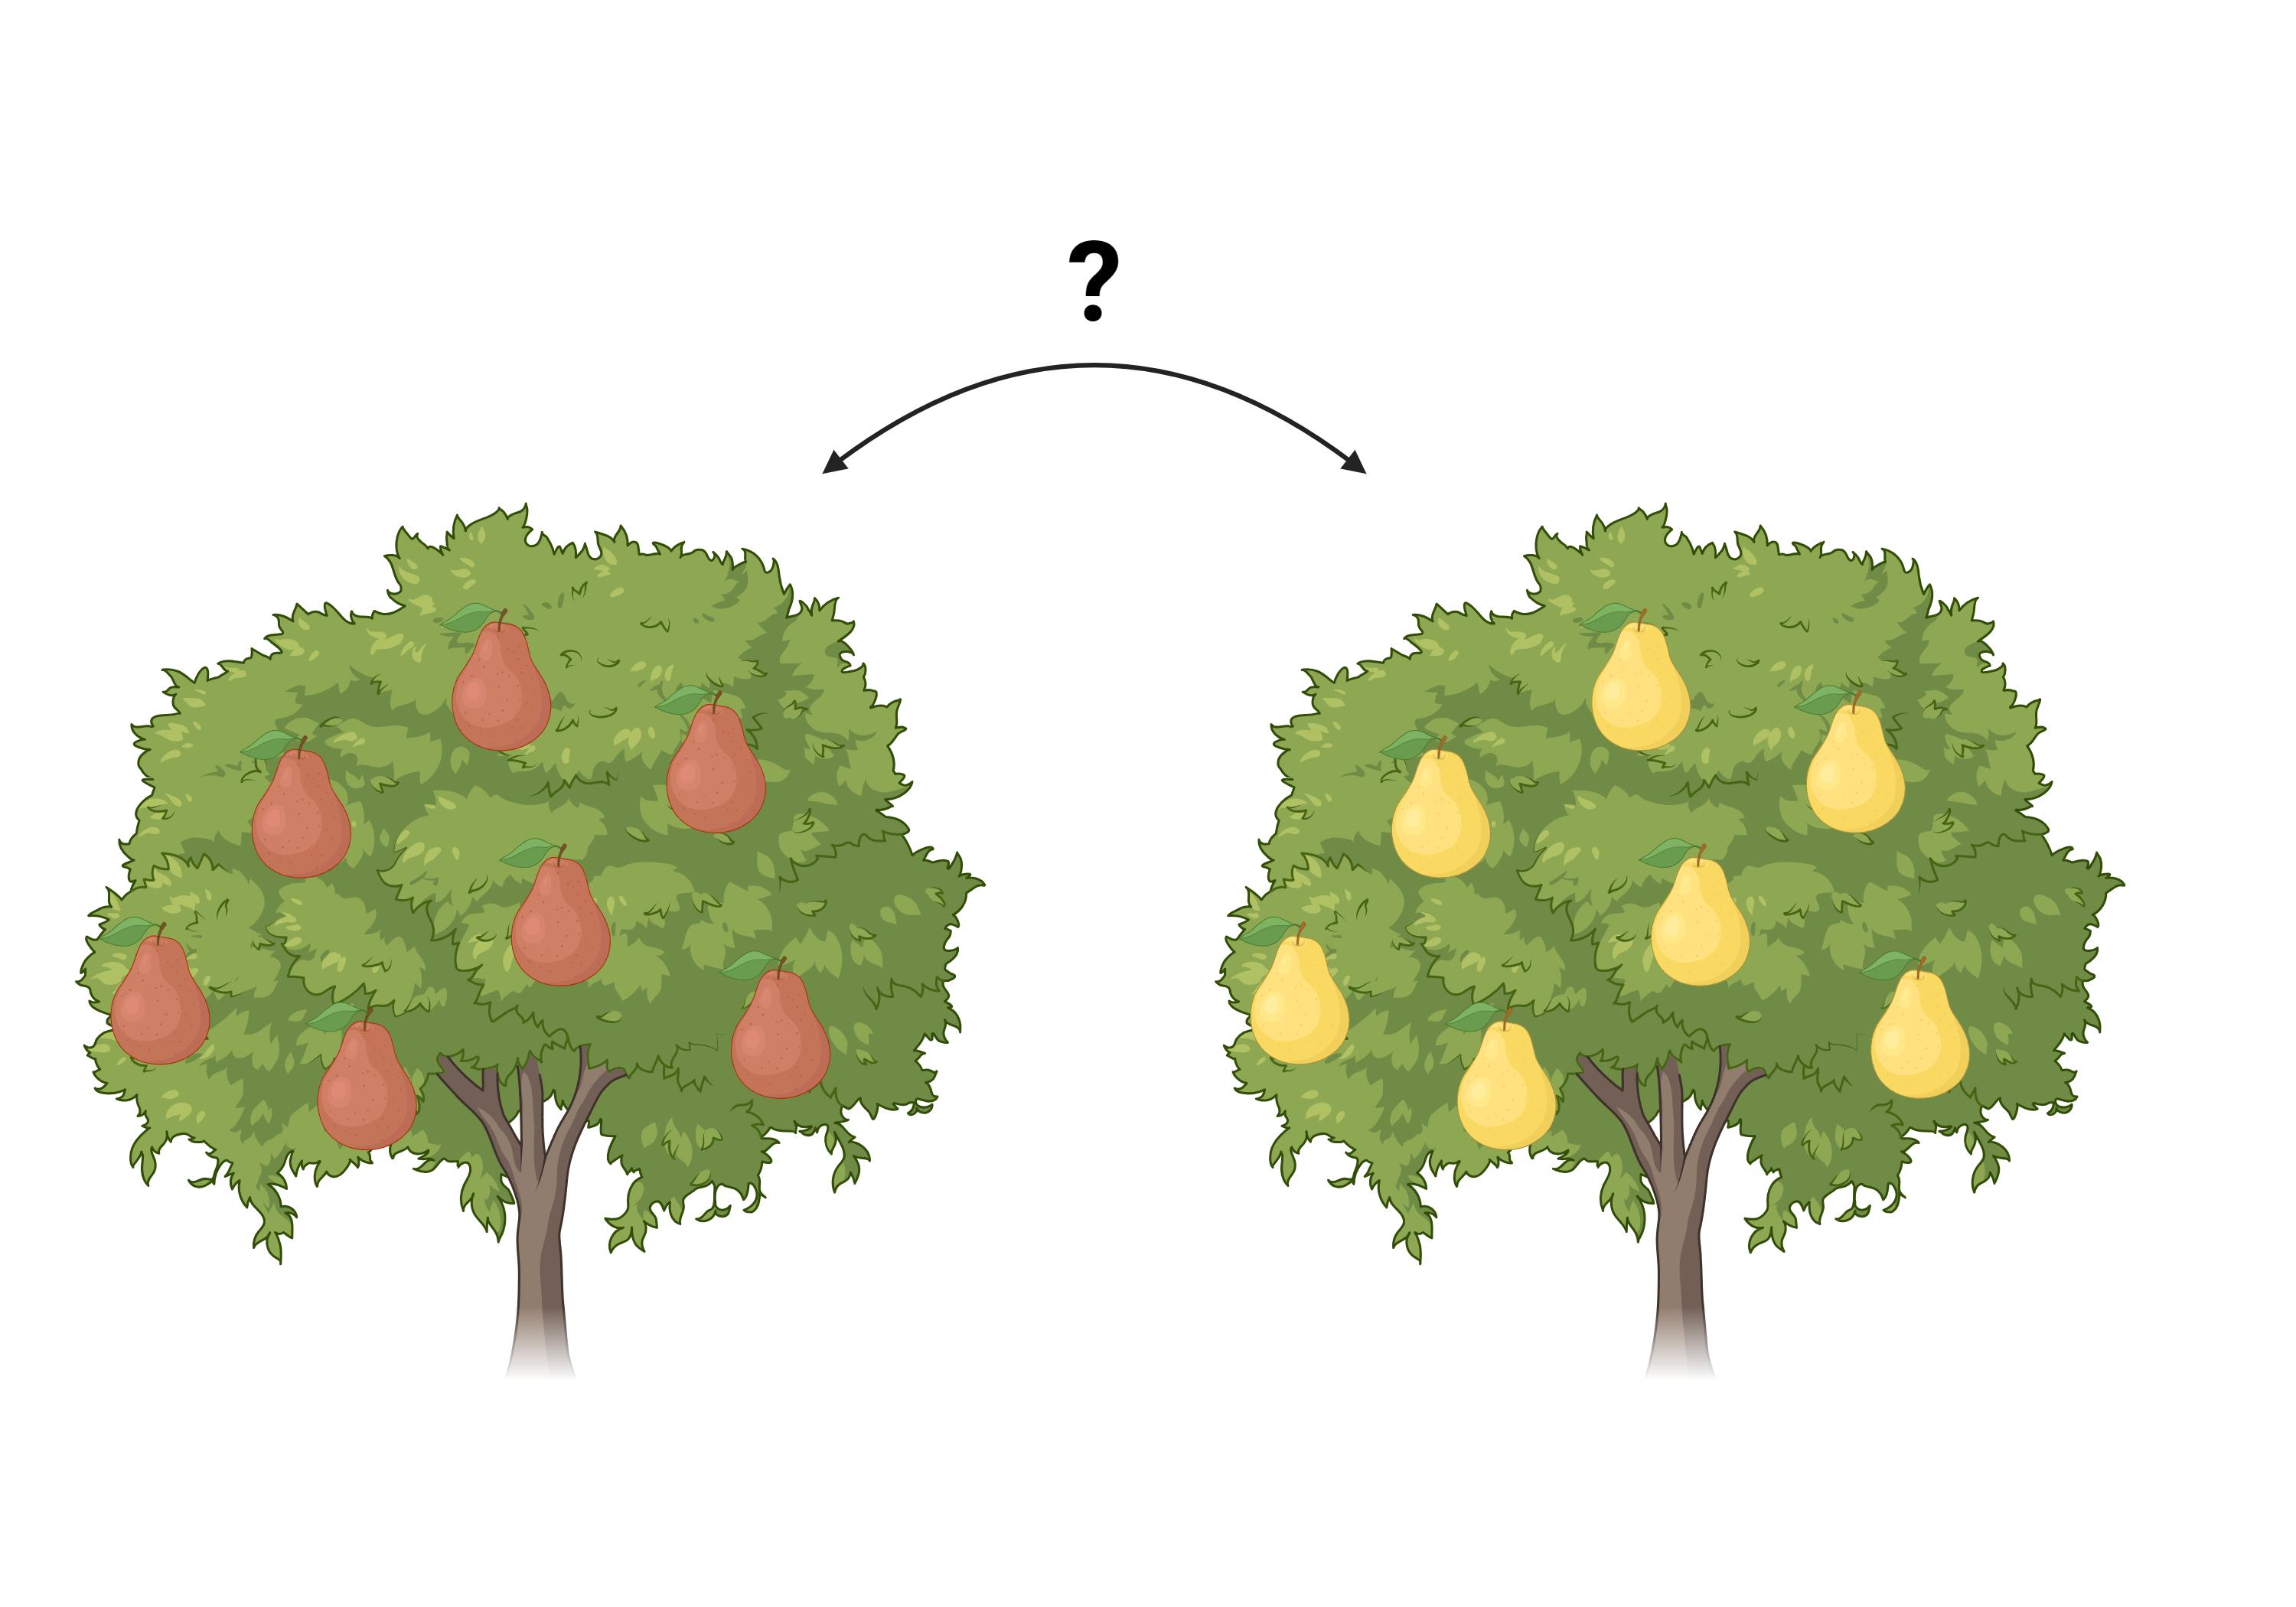
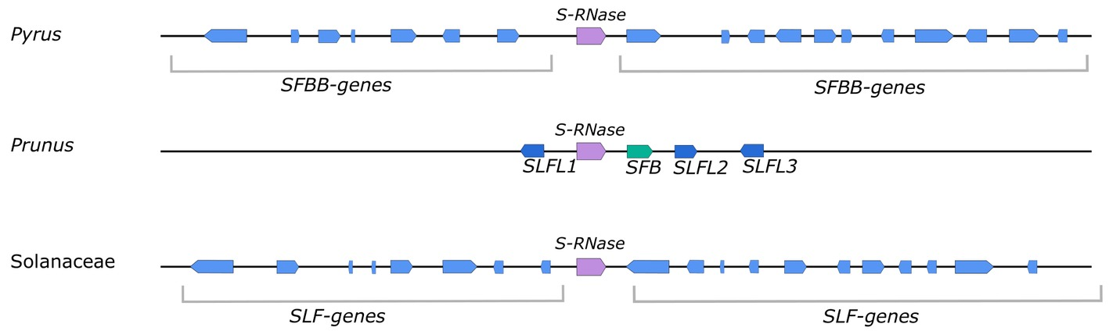
Introduction:
Mechanism in plants that prevents self-fertilization
Protection against inbreeding
Genetically controlled by the S-locus
Images credit: biorender.com

Slide 3
Introduction:
Mechanism in plants that prevents self-fertilization
Protection against inbreeding
Genetically controlled by the S-locus
Goal: obtain the S-locus haplotypes from cultivar “Conference”
=> Phased genome assembly
Images credit: biorender.com

Slide 4
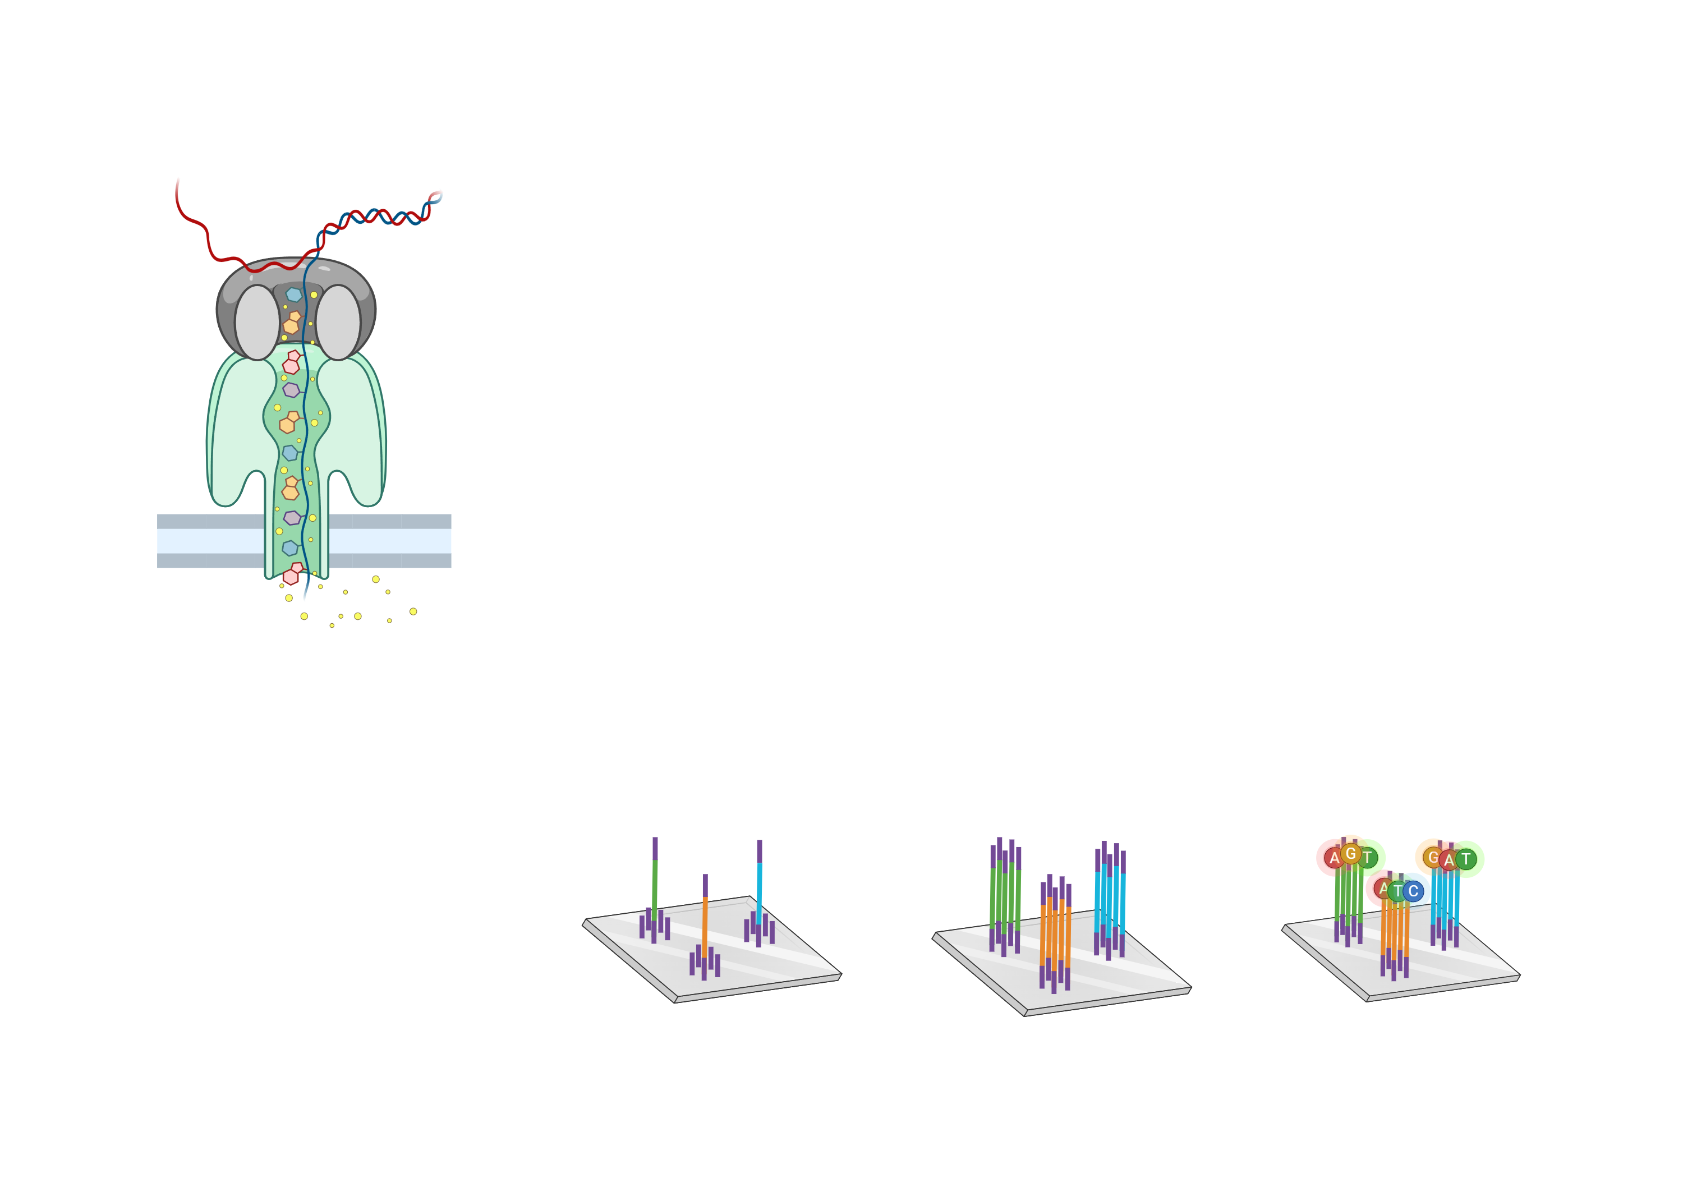
Introduction: raw data
Nanopore ONT long-read sequencing
PromethION at 150x coverage
R9.4 Flow cell
Long reads, but low accuracy
Illumina short-read sequencing
NovaSeq6000
150bp paired-end 100x coverage
Short reads, high accuracy
Images credit: biorender.com

Slide 5
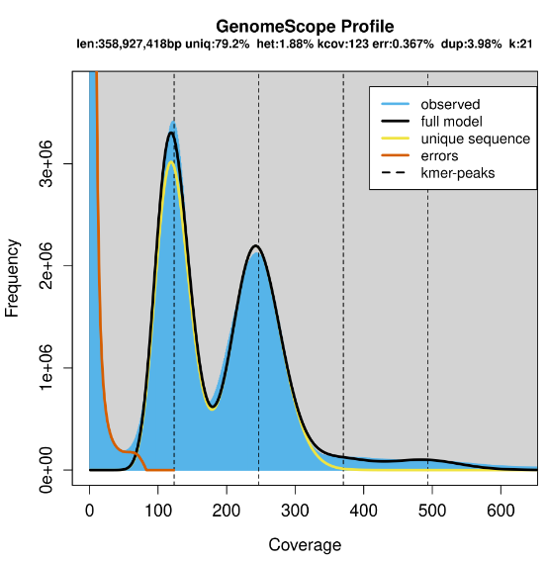

Genome characteristics
Pyrus communis (European pear)
Diploid species
Whole genome duplication (~45M years)
1,88% heterozygosity
20,8% repeated sequences
358 Mb
https://github.com/schatzlab/genomescope

Slide 6
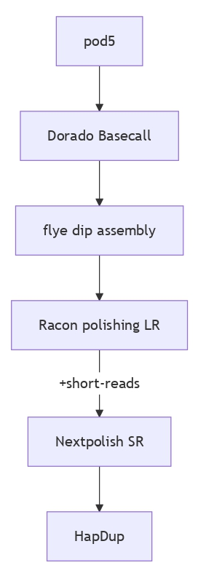
Workflow:
Old data
Heterozygous genome
Phasing with limited data

Slide 7
“Old” data – solutions?
Dorado rebasecalling
Herro
Haplotype-aware ERRor cOrrection
Deep-learning tool for error correction
Experimental model for R9.4.1 data
Parameter | Original | Rebasecalled
Mean read length | 12 794,5 | 13 501,5
Mean read quality | 8,6 | 11,3
https://github.com/wdecoster/NanoPlot
https://github.com/lbcb-sci/herro

Slide 8
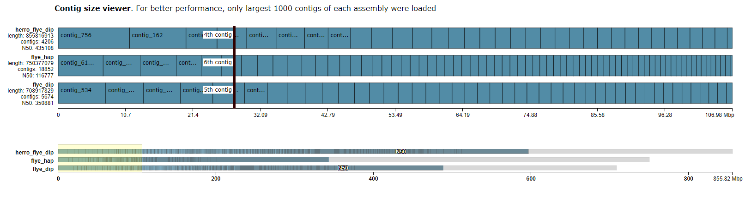
“Old” data – solutions?
 | Herro_flye_dip | Flye_hap | Flye_dip
Busco_C | 99,1 | 98,3% | 98,5%
Busco_C(S) | 30,4% | 48,8% | 56,6%
Busco_C(D) | 68,7% | 48,5% | 42,3%
Busco_F | 0,6% | 1,1% | 1,0%
Busco_M | 0,3% | 0,6% | 0,5%
https://github.com/ablab/quast

Slide 9
“Old” data – solutions?
Dorado rebasecalling
Herro
Haplotype-aware ERRor cOrrection
Deep-learning tool for error correction
Experimental model for R9.4.1 data
Parameter | Original | Rebasecalled
Mean read length | 12 794,5 | 13 501,5
Mean read quality | 8,6 | 11,3
https://github.com/lbcb-sci/herro

Slide 10
“Old” data – solutions?
Where to incorporate Illumina data?
Possible levels:
Hybrid read correction Hero/haplokit
Hybrid assembly Spades, HASLR…
Assembly polishing Pilon/Racon/Nextpolish….
After phasing Hapo-G

Slide 11
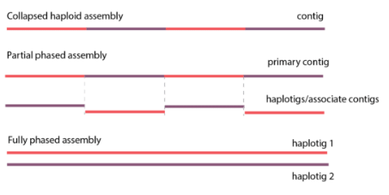
Heterozygous genome and assembly
Most assemblers produce collapsed assembly
Often another tool is used to recover haplotypes
E.g. Flye → HapDup
Problem if highly heterozygous:
Assembler separates heterozygous regions
Images credit: https://www.pacb.com/human-genetics-research/direct-phased-genome-assembly-using-nighthawk-on-hifi-reads/

Slide 12
Heterozygous genome and phasing
HapDup output without purging haplotigs
S121
S121
S108
S108
S121_v1
S121
S108_v1
S108
S121_v2
S108_v2
“Haplotype-resolved” assemblies
Flye assembly
HapDup
12

Slide 13
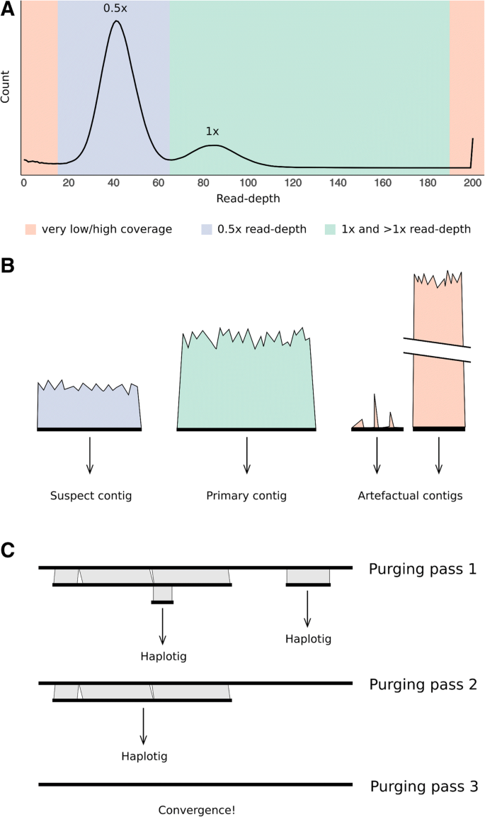
Heterozygous genome – solutions?
Roach et al. (2018) BMC Bioinformatics

Slide 14
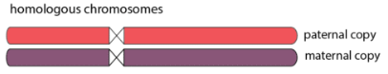
Phasing with limited data
Best case phasing result = pseudo haploid
Homozygous/inbred individuals
DH pear line
More data:
Methylation calls
Hi-C
Trio-binning
Gamete-based phasing
Images credit: https://www.pacb.com/human-genetics-research/direct-phased-genome-assembly-using-nighthawk-on-hifi-reads/

Slide 15
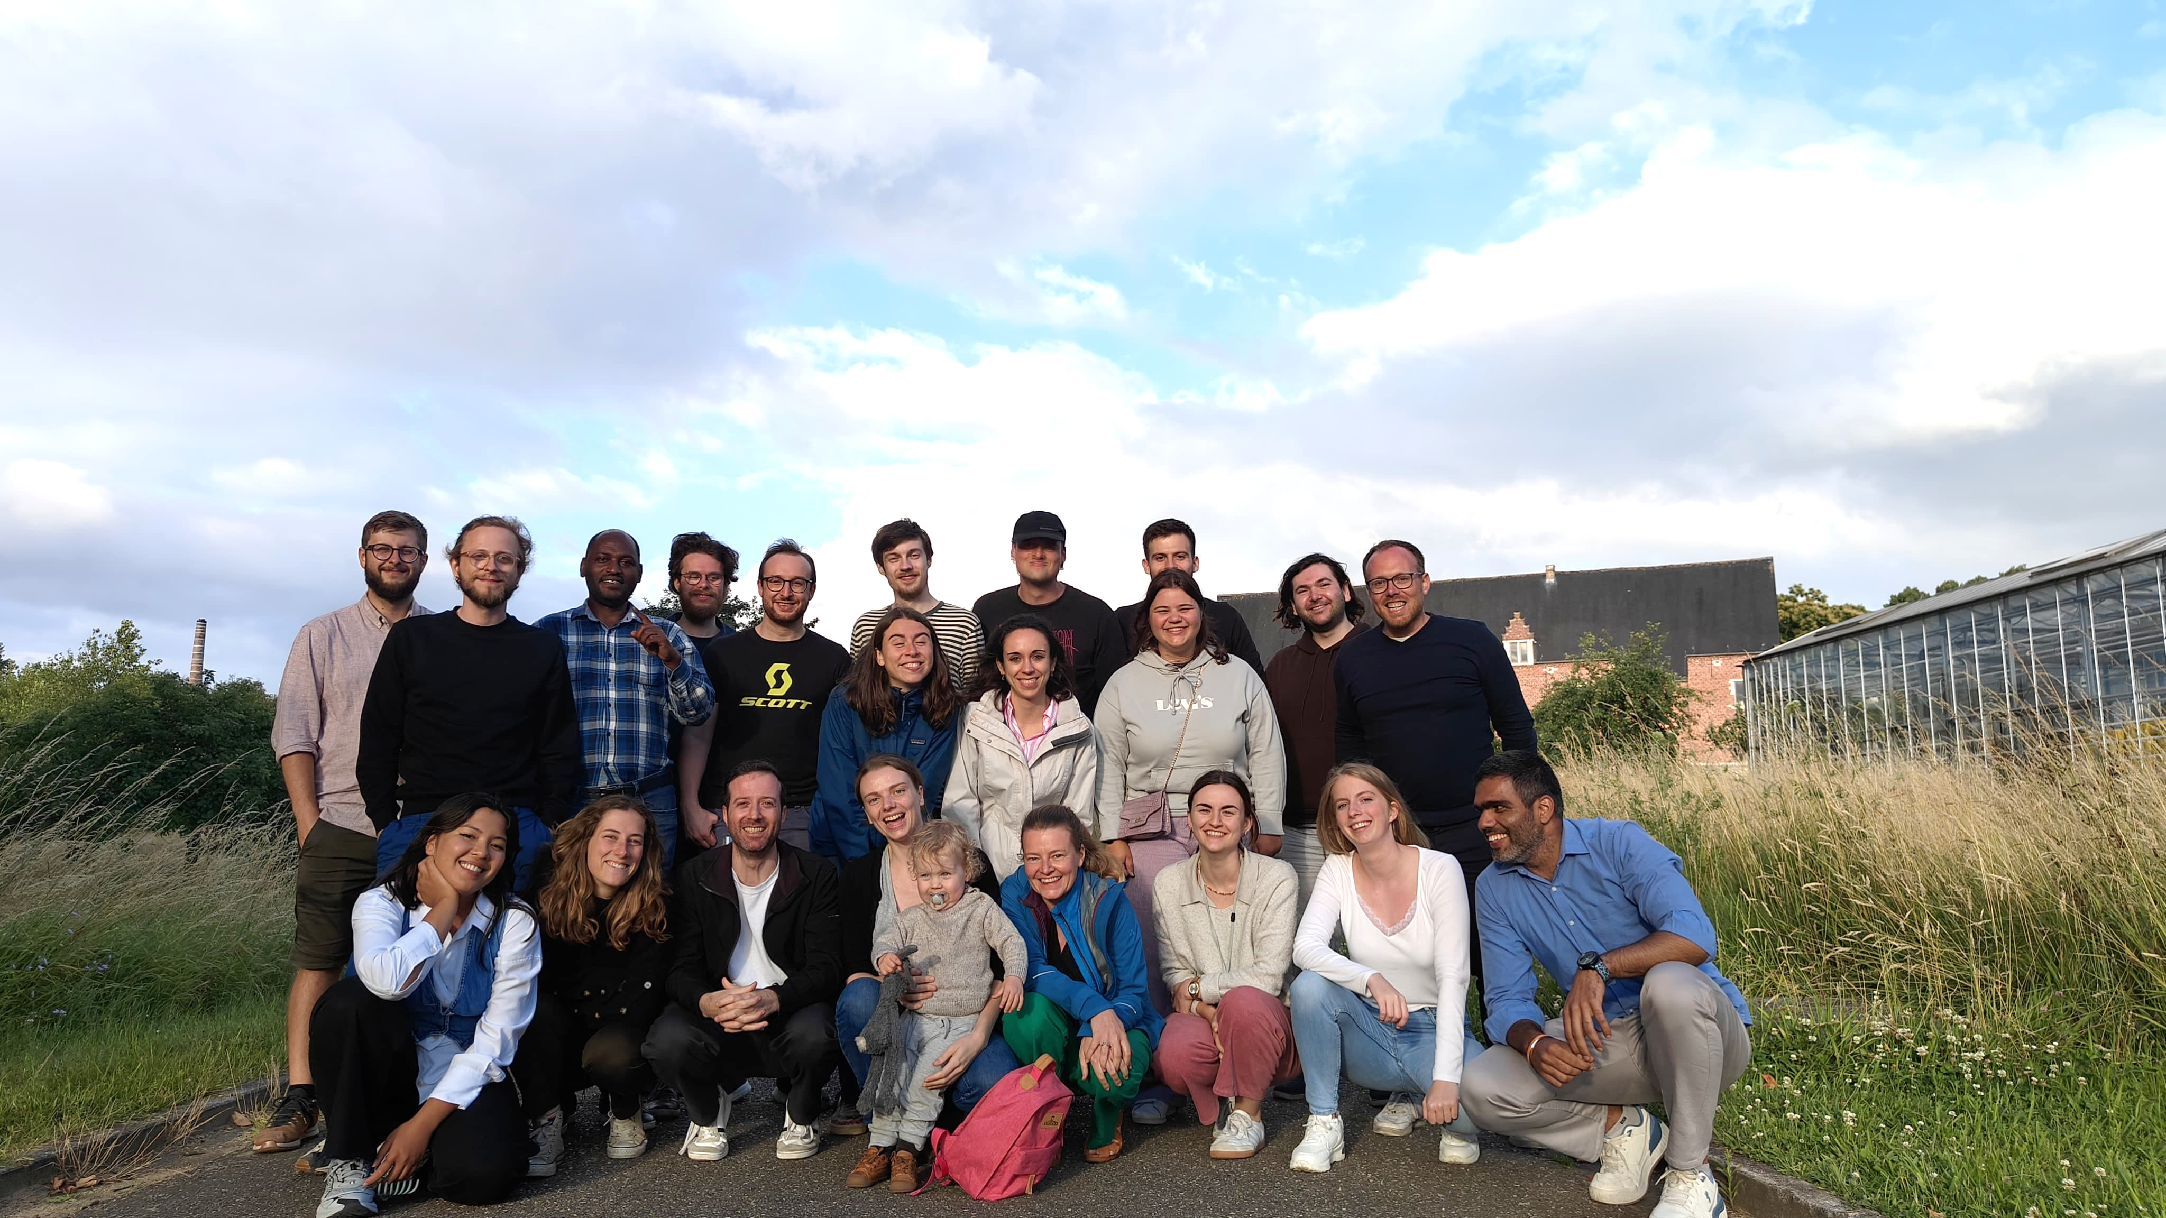
Thank you!
PGCI Lab
Prof. Nico De Storme
Pollien Aert
Tine Verhoeven
Genomics Core
Enora Geslain
Álvaro Cortés Calabuig
Wouter Bossuyt

